Slide 1

Adaptive Charging Network
Steven Low
LACI, December 2018
Notes:
Caltech ACN
Dec 9, 2016: GlobalSIP, Washington DC (invited Meng Wang)
March 30, 2017 NSF: Barbara Kenny, Prakash Balan AIR PM, Arlington, VA
February 12, 2018: Real-time learning & decision making in dynamic systems, NSF Workshop (Le Xie, TAMU)
August 4, 2018: NSF Workshop on real-time learning & decision making for grid resilience (ANURAG K SRIVASTAVA)
Sept 19, 2018: Caltech Facilities (John Onderdonk)
Dec 12, 2018: LACI (Ken Pickar)

Slide 2






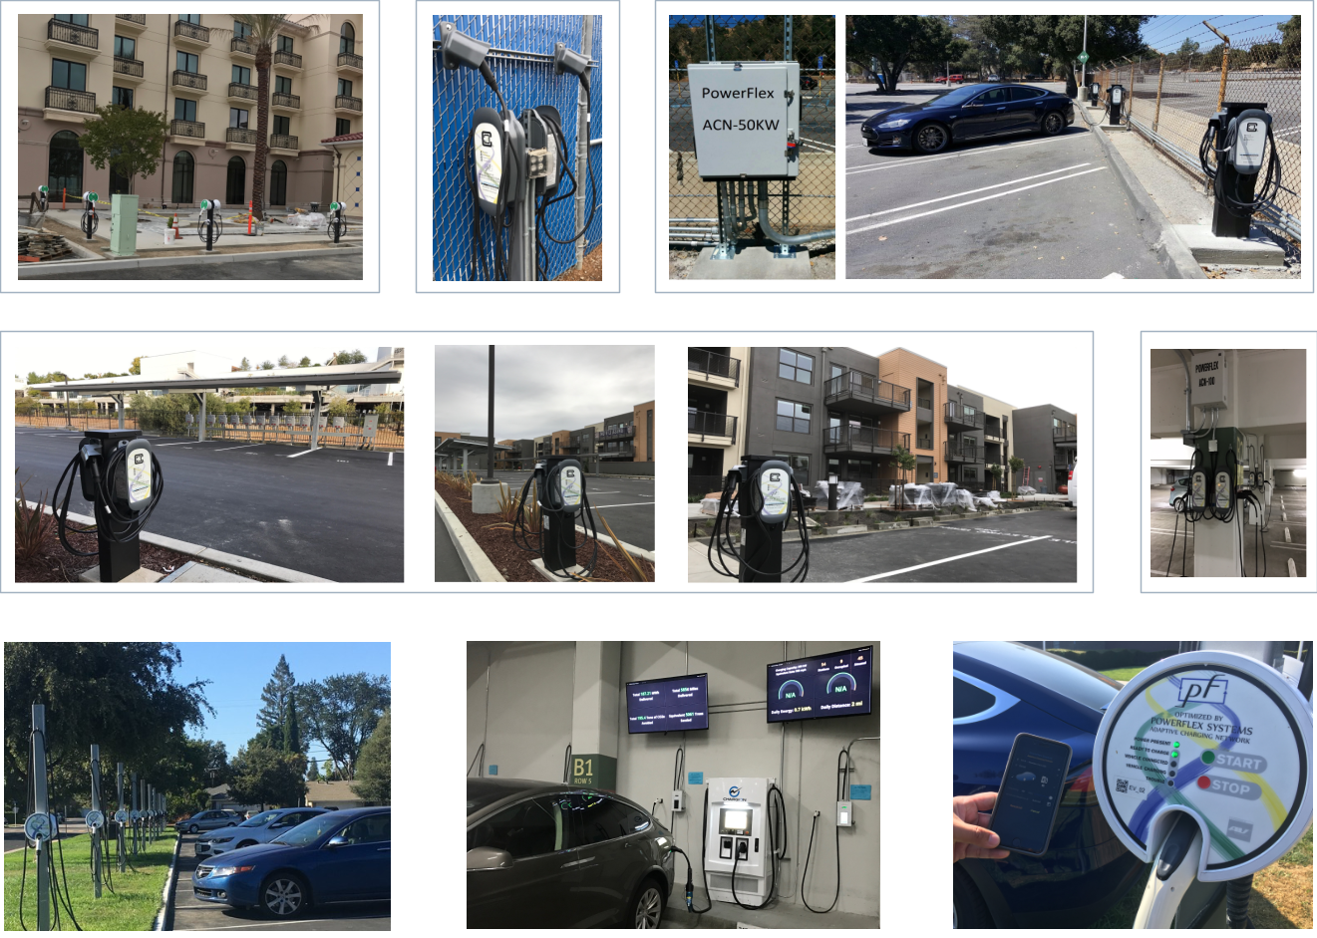










research
commercialization
2012
2017
Joint DER opt +
Energy Services
EV Charging
Energy mgt research
Incubation to launch
Notes:
Our vision for PF also has two stages: In PF Stage 1, we will build a product to provide large-scale EV charging at minimum capital and operating costs. In PF Stage 2 when we have a large number of EVs under management, we will also provide energy services to ISOs and utilities on top of our EV management platform. Both revenue streams are critical to make the venture work.
CalSEED I was one of the earliest grants we received that helped get PF Stage 1 started. We were also lucky enough to have received NSF SBIR I and Wells Fargo/NREL’s IN2 grant around the same time. We are actively building the technologies and business for large-scale EV charging.
CalSEED II will allow us to explore some of our Stage 2 ideas, while continue to build our Stage 1 business.
In the following, we will first explain what we have achieved during CalSEED Phase 1, the motivating problem, our solution, the product we have built, its performance and market traction to date, as well as projections and financials.
We will then propose an R&D plan with the CalSEED Phase 2 grant that builds on our CalSEED 1 results, how it fits into our business plan, and how it will benefit CA ratepayers and help advance CEC’s energy goals.

Slide 3
Watershed Moment
Tesla: multi-phase AC
Deregulation
started
IoT
1888
both started as natural monopolies
both provided a single commodity
both grew rapidly through two WWs
1980-90s
1876
1980-90s
Bell: telephone
Deregulation
started
convergence
to Internet
1969: DARPAnet

Slide 4
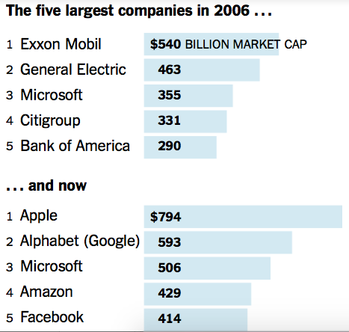
Watershed Moment
Power system will undergo a similar architectural transformation that communication network went through
Industry will be restructured
Infrastructure will be reshaped
Control paradigms will be upended
Markets will be revolutionized
(April 2017)
What will drive power
network transformation?

Slide 5
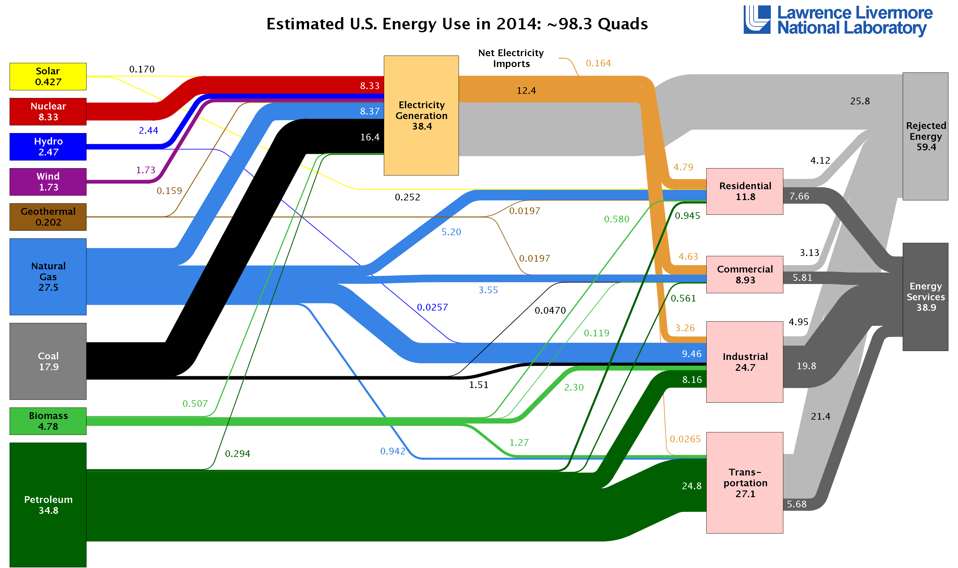
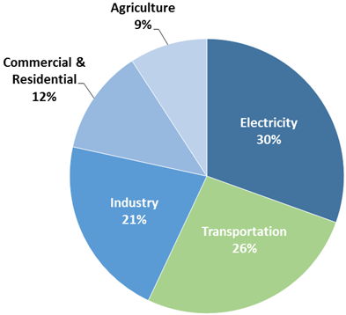
Electricity Generation and Transportation
Source: USEPA
Consumes 2/3 of All Energy and Emits 1/2 of All Greenhouse Gases (2014)

Slide 6
Today’s Grid
Few large generators
~10K bulk generators, actively controlled
Many dump loads
131M customers, ~billion passive loads
Control paradigm: Schedule supply to match demand
Centralized, human-in-the-loop, worst-case, deterministic

Slide 7
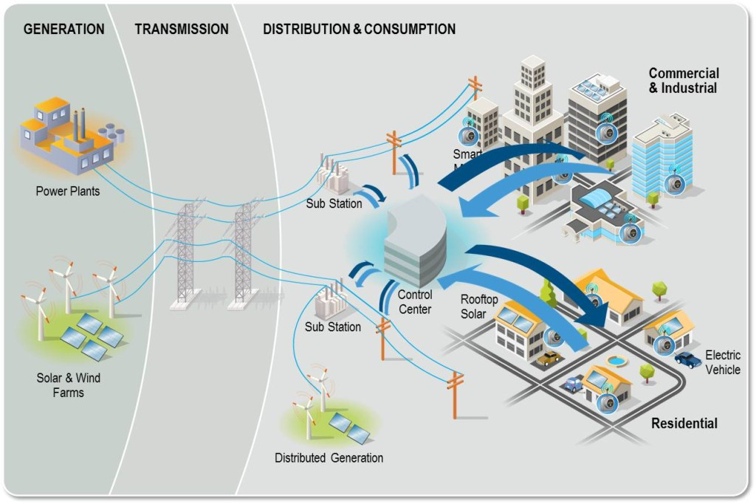
Future Grid
Wind and solar farms are not dispatchable
Many small distributed generations
Network of distributed energy resources (DERs)
EVs, smart buildings/appliances, wind turbines, storage
Control paradigm: Adapt demand to volatile supply
Distributed, real-time feedback, risk limiting, robust

Slide 8
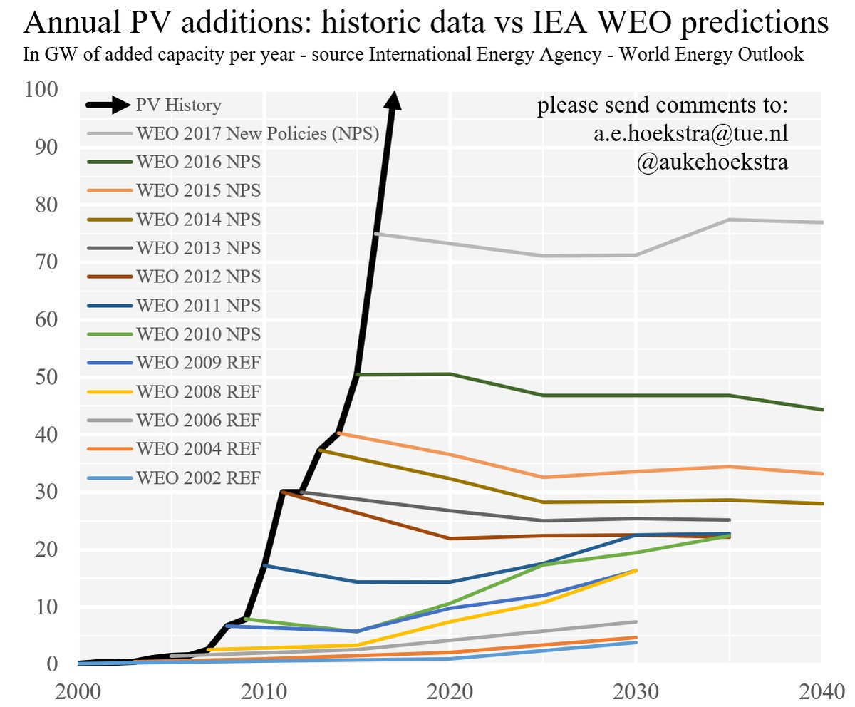
Scale: Billions of DERs are coming as IoT emerges...
Historic data vs IEA WEO predictions (GW of annual added capacity)
Source: International Energy Agency - World Energy Outlook

Slide 9
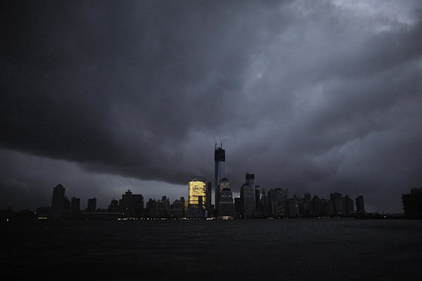
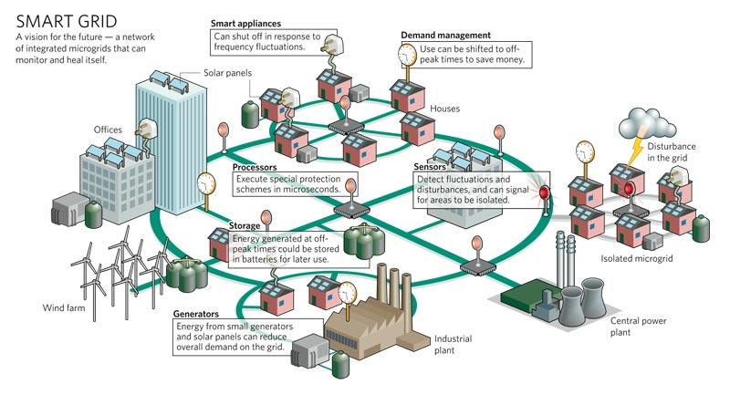
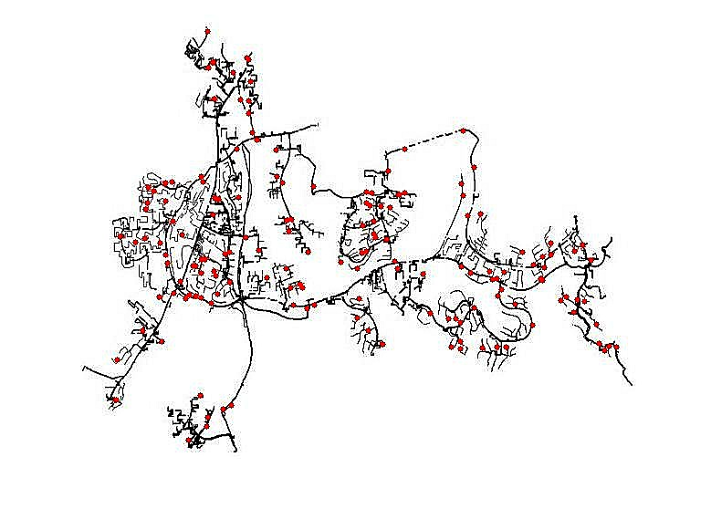
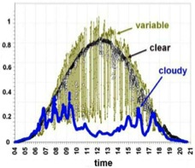







Caltech Research
Risk
Active DERs introduce rapid random
fluctuations in supply, demand, power quality, increasing risk of blackouts
Opportunity
Active DERs enable real-time dynamic network-wide feedback control, improving robustness, security, efficiency
Distributed control of networked DERs
Foundational theory, practical algorithms, concrete applications
Integrate engineering and economics
Active collaboration with industry

Slide 10
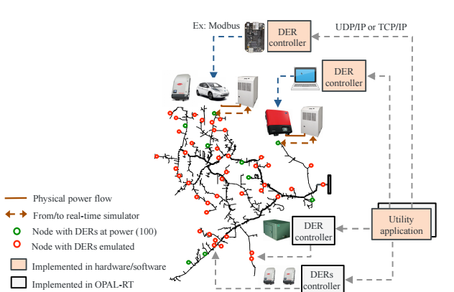
Sample Projects
Projects on DERs
Control & optimization
Markets and market power
NREL testbeds
EV charging deployment

Slide 11
research
commercialization
2012
2017
Joint DER opt +
Energy Services
EV Charging
Energy mgt research
funding >$10M
Incubation to launch
Notes:
Our vision for PF also has two stages: In PF Stage 1, we will build a product to provide large-scale EV charging at minimum capital and operating costs. In PF Stage 2 when we have a large number of EVs under management, we will also provide energy services to ISOs and utilities on top of our EV management platform. Both revenue streams are critical to make the venture work.
CalSEED I was one of the earliest grants we received that helped get PF Stage 1 started. We were also lucky enough to have received NSF SBIR I and Wells Fargo/NREL’s IN2 grant around the same time. We are actively building the technologies and business for large-scale EV charging.
CalSEED II will allow us to explore some of our Stage 2 ideas, while continue to build our Stage 1 business.
In the following, we will first explain what we have achieved during CalSEED Phase 1, the motivating problem, our solution, the product we have built, its performance and market traction to date, as well as projections and financials.
We will then propose an R&D plan with the CalSEED Phase 2 grant that builds on our CalSEED 1 results, how it fits into our business plan, and how it will benefit CA ratepayers and help advance CEC’s energy goals.

Slide 12
Agenda
Caltech Adaptive charging network (ACN)
Physical infrastructure
Charging statistics
Research platform
Model and algorithms
Linear program
Smoothed least laxity first

Slide 13
ACN: physical infrastructure

Slide 14
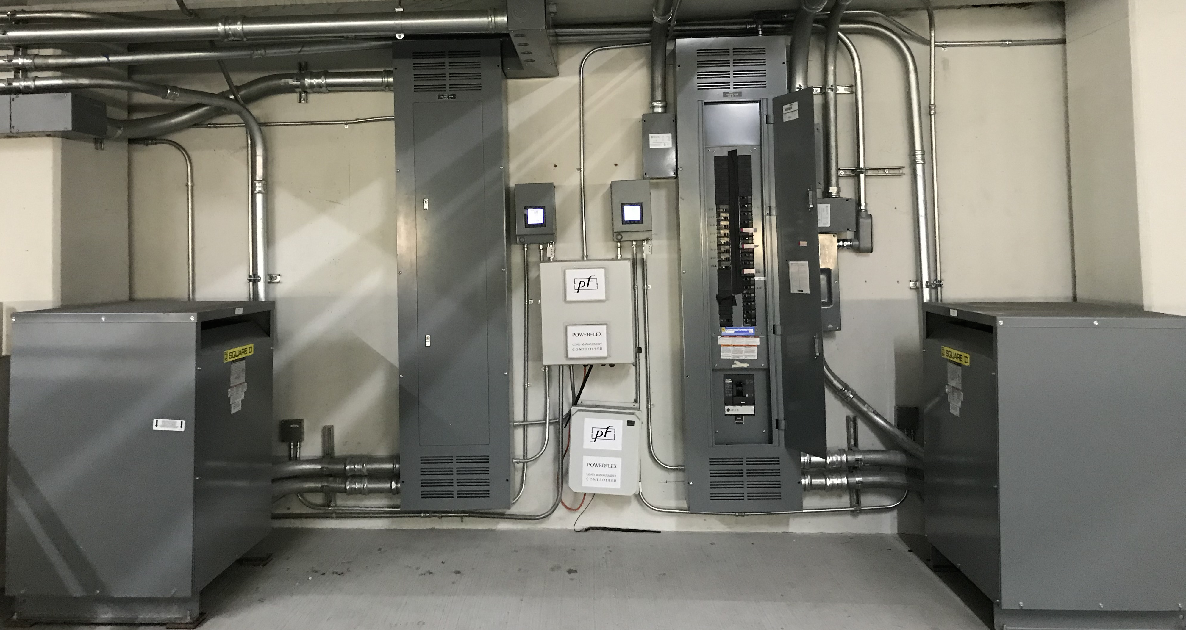
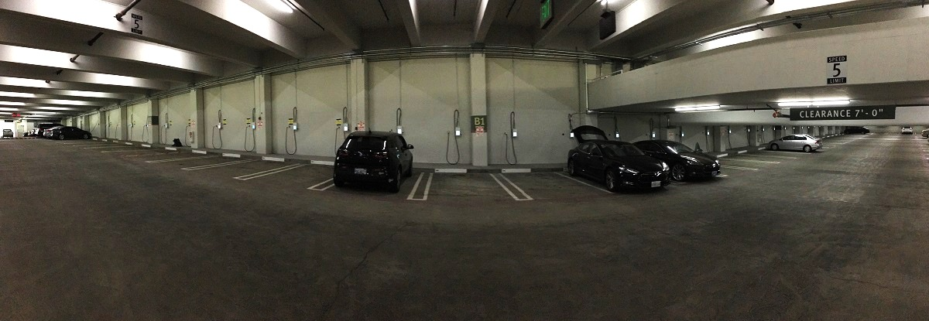

Slide 15
Caltech Adaptive Charging Network

Slide 16
Caltech Adaptive Charging Network

Slide 17
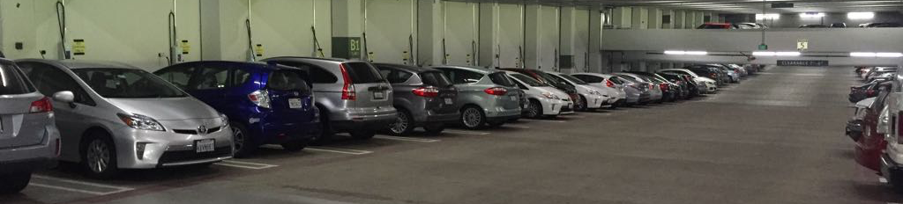
Caltech Adaptive Charging Network
Operational since 2016
Experimental platform in continuous development
Delivered ~550MWh (by 9/2018)
Equivalent to 1.7M miles, 570 tons of avoided CO2e

Slide 18
Caltech Adaptive Charging Network
industry
standard
our algorithm
 | Emerging product | Online LP | Theoretical max
Caltech | 28% | 53% | 54%
Early theory work:
Gan, Topcu, Low, Optimal decentralized protocol
for EV charging, IEEE Trans. on Power Systems, 2013
Theorem (Guo, Erliksson, Low, 2016)
Online LP attains offline optimal

Slide 19
Deployment
Sept 2018

Slide 20
ACN: statistics

Slide 21
Caltech ACN
energy delivered & impact to date
charging station utilization
peak power
power utilization
today’s
energy delivered
Caltech ACN snapshot Sept 17, 2018

Slide 22
Caltech ACN
2016: 67 MWh
2017: 186 MWh
2018: 191 MWh

Slide 23
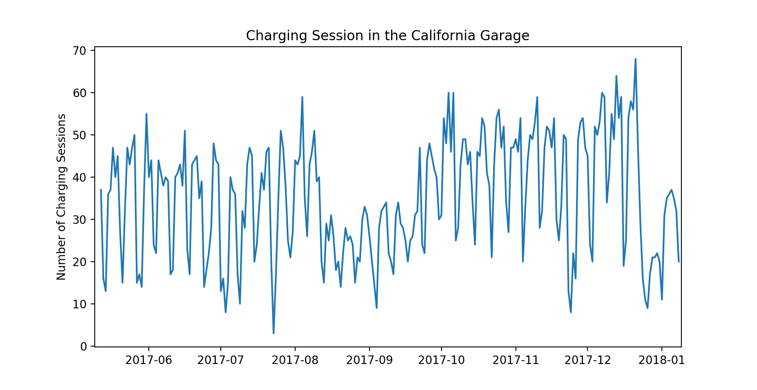
Caltech ACN
100
daily #charging sessions (April 15 – Sept 18, 2018)
80
60
40
20
may
june
july
august
septemer

Slide 24
Caltech ACN
hourly # charging sessions
weighted averages
Caltech ACN
April 15 – Sept 18, 2018

Slide 25
Caltech ACN
hourly aggregate charging power
weighted averages
Caltech ACN
April 15 – Sept 18, 2018

Slide 26
Caltech ACN
Caltech ACN
April 15 – Sept 18, 2018

Slide 27
Caltech ACN
Caltech ACN
April 15 – Sept 18, 2018

Slide 28
Caltech ACN
arrival & departure hours
duration
energy delivered
Caltech ACN
June 1-29, 2018
Total# sessions: 1,780

Slide 29
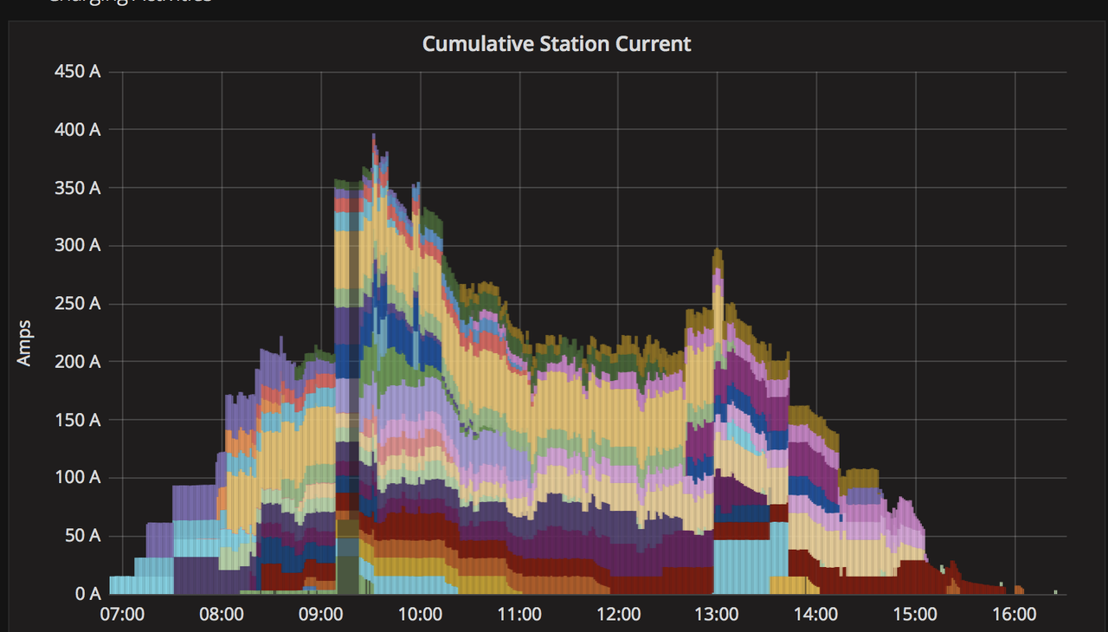
Caltech ACN
cumulate charging current
Jan 2018

Slide 30
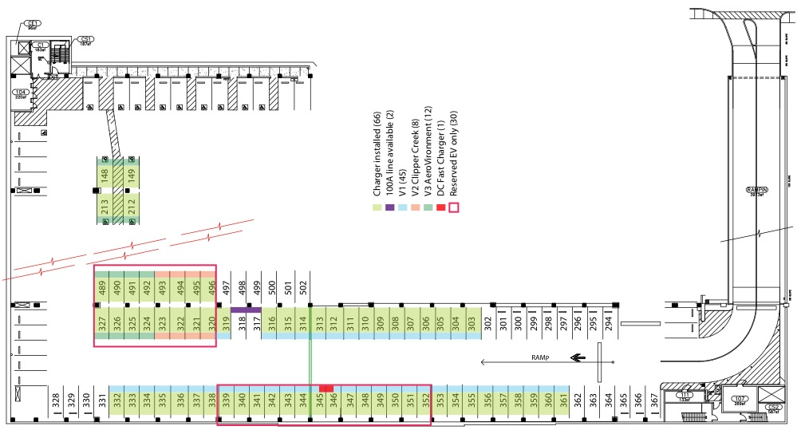
Caltech ACN
Spatial utilization snapshot (June 1 – August 31, 2018)
 | total | per day | per space | remark
#parking spaces | 53
#days (June 1 – Aug 31, 2018) | 92 |  |  | inc. weekends
#charging sessions | 6,103 | 66 | 115 | >1 session /space/day
occupancy (space-day) | 3,374 | 37 | 64 | 69% occupancy
energy delivered (kWh) | 54,562 | 593 | 1,029 | 11 kWh /space/day
#hours occupied | 28,407 | 309 | 536 | 5.8 hours /space/day

Slide 31
CAN: ongoing research

Slide 32
Undergrad research
ACN used for 16 undergrad projects (2016 – 2018)
22 undergrads: 20 Caltech, 2 Lund (Sweden), 4 female
2016: 1 class project, 1 Directed Study, 4 SURF projects
2017: 1 class project, 2 Directed Studies
2018: 5 class projects, 1 Directed Studies, 1 SURF project
Notes:
Critical gap in algorithm research. The mathematical or simulation models used in algo- rithm research for smart grid tend to be drastically simpler (and often unrealistic) compared to a real system for which an algorithm is designed. By abstracting away many complicating details, mathematical analysis often allows us to uncover hidden structures of the problem, leading to new qualitative insights and new algorithmic designs. There is however a sizable gap between theo- retical results and a robust and high performance implementation of an algorithm. If one aspires to apply some of one’s theory results to design algorithms that can make an impact in practice, bridging this gap will be critical. It will require, beyond mathematical analysis:
1. Detailed simulations driven by realistic models and data. 2. The ability to test an algorithm implementation in the field.
Often, the bottleneck in crossing this gap is the lack of realistic models and data for simulations and opportunity for field test. We propose to build a novel infrastructure to help overcome this bottleneck and enable new algorithm research in the smart grid space, especially electric vehicles research.

Slide 33
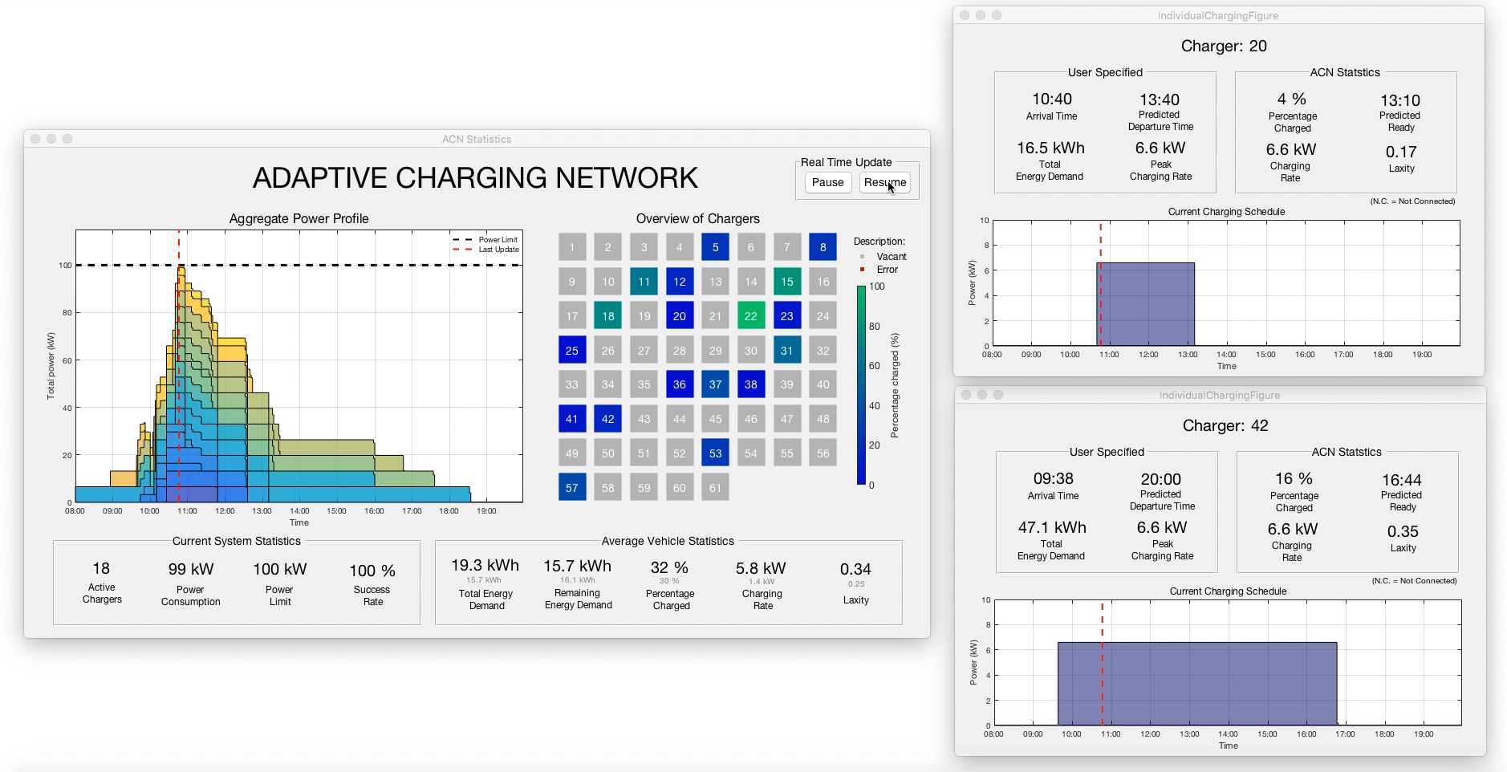
Undergrad research
Karl Erliksson 2016 SURF (Lund)
ACN visualization
Notes:
Critical gap in algorithm research. The mathematical or simulation models used in algo- rithm research for smart grid tend to be drastically simpler (and often unrealistic) compared to a real system for which an algorithm is designed. By abstracting away many complicating details, mathematical analysis often allows us to uncover hidden structures of the problem, leading to new qualitative insights and new algorithmic designs. There is however a sizable gap between theo- retical results and a robust and high performance implementation of an algorithm. If one aspires to apply some of one’s theory results to design algorithms that can make an impact in practice, bridging this gap will be critical. It will require, beyond mathematical analysis:
1. Detailed simulations driven by realistic models and data. 2. The ability to test an algorithm implementation in the field.
Often, the bottleneck in crossing this gap is the lack of realistic models and data for simulations and opportunity for field test. We propose to build a novel infrastructure to help overcome this bottleneck and enable new algorithm research in the smart grid space, especially electric vehicles research.

Slide 34
Live testbed
Motivation
Math or simulation models in algorithms research tend to be unrealistic
Bridging gap between theory and practice requires realistic models & data for simulations and opportunity for field test
Notes:
Critical gap in algorithm research. The mathematical or simulation models used in algo- rithm research for smart grid tend to be drastically simpler (and often unrealistic) compared to a real system for which an algorithm is designed. By abstracting away many complicating details, mathematical analysis often allows us to uncover hidden structures of the problem, leading to new qualitative insights and new algorithmic designs. There is however a sizable gap between theo- retical results and a robust and high performance implementation of an algorithm. If one aspires to apply some of one’s theory results to design algorithms that can make an impact in practice, bridging this gap will be critical. It will require, beyond mathematical analysis:
1. Detailed simulations driven by realistic models and data. 2. The ability to test an algorithm implementation in the field.
Often, the bottleneck in crossing this gap is the lack of realistic models and data for simulations and opportunity for field test. We propose to build a novel infrastructure to help overcome this bottleneck and enable new algorithm research in the smart grid space, especially electric vehicles research.

Slide 35
Live testbed
Notes:
The goal of the proposed project is to develop a suite of software and hardware that will make Caltech ACN not just a production EV charging facility after mid 2018, but also a live testbed for researchers at, and outside, Caltech. It will enable research on data science and online algorithms for smart grid, based on real driver behavior and real charging data.
Our basic idea is to treat the production ACN as a physical layer and create an intermediate layer, called the ACN Research Portal, that will have a well-designed interface to the PowerFlex management system in the cloud. The Research Portal both provides interfaces and clean anonymized data to, and protects the physical layer from, the research layer above.
System components. The ACN Research Portal consists of three main components.
1. A data acquisition system that will automatically collect, extract, clean, anonymize, and visualize high-resolution charging data in real time.
2. A data-driven simulator that can drive simulations by replaying real consumer behavior and mimicking the behavior of batteries and chargers using models derived from real data. This simulator will also automatically evaluate the safety, security, and performance of a charging or pricing algorithm for suit- ability before deploying the algorithm on ACN.
3. An experimental platform that will allow safe, secure and reliable real-world testing of new online algorithms on ACN along side the production algorithm. It captures all the complications of a physical system that are abstracted away in a simulation model, and demands a higher degree of

Slide 36
EV potential for grid service
Behind-the-meter DR potential will only increase
CA: 50% renewables by 2030, 100% by 2045
CA: 1.5M ZEV by 2025, 5M by 2030
Potential value of EV for DR service @1.5M EVs : $50B / yr (2025)
CA Duck Curve
Oct 22, 2016
Shift service
Shimmy service
Source: 2025 CA DR Potential Study (LBNL 2017)
Notes:
Unique strengths
Team has been working together for 15 years at Caltech and FastSoft
Leading experts in energy systems, networking, cloud-computing
... covering EV charging, advance algorithms, software dev, IT, protocols
Experience in startup, invention, building & managing talented team

Slide 37
EV potential for grid service
Behind-the-meter DR potential will only increase
CA: 50% renewables by 2030, 100% by 2045
CA: 1.5M ZEV by 2025, 5M by 2030
Potential value of EV for DR service @1.5M EVs : $50B / yr (2025)
CA Duck Curve
Oct 22, 2016
 | Annual DR value
Shift service | $190 / EV
Shimmy service | $150 / EV
@1.5M EV | $50B
3M EV workplace charging
@10kWh/EV
Shift service
Assumptions: DR value from 2025 CA DR Potential
Study (LBNL 2017); each EV drives 12K miles/year,
needs 11kWh/day, workplace charging; 10% provide DR
Shimmy service
Source: 2025 CA DR Potential Study (LBNL 2017)
Notes:
Unique strengths
Team has been working together for 15 years at Caltech and FastSoft
Leading experts in energy systems, networking, cloud-computing
... covering EV charging, advance algorithms, software dev, IT, protocols
Experience in startup, invention, building & managing talented team

Slide 38
utility input
ISO input
PF cloud
ACN input
utilities
ISO markets
distribution
grid
transmission
grid
. . .
ACN
ACN
driver
input
PF cloud
input
driver
input
PF cloud
input

Slide 39
Duck Curve & DCM
building – PV + EV
building – PV (weekday)
NREL: demand charge mitigation (Nov 2018)
Filling Duck Curve valley and maintaining total net load to grid between 30 kW – 40 kW
On weekdays: building load is much higher and much more volatile
building – PV (weekend)
Weekend Duck Curve: building baseload (10kW) – PV
Notes:
This is an NREL experiment where DCM is running on a building that has PV (previous experiment did not have PV). The experiment started today, which is why I didn't have a plot like this before...
See Ted’s email Oct 15, 2018
The blue line is an NREL building site load + PV. The duck curve is apparent here.
The orange line is the NREL building site load + PV + EVs with DCM. There is a high bump in the orange between 7:30AM and 9:30AM because I had to make some settings changes. These changes were finished at 9:30AM and you can see the orange line was pretty stable for the rest of the day. Tomorrow's plot will look pretty flat.

Slide 40
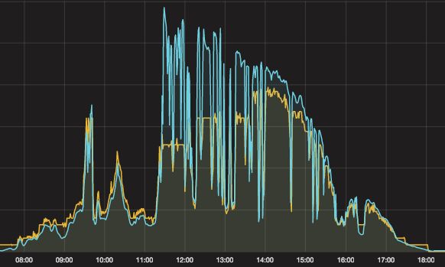
Online tracking
PV
charging rate
(EVSE)
Real-time tracking of PV generation at JPL (10/2016)

Slide 41
Agenda
Caltech Adaptive charging network (ACN)
Physical infrastructure
Charging statistics
Research platform
Model and algorithms
Linear program
Smoothed least laxity first

Slide 42
Model and algorithms:
LP

Slide 43
Charging model
energy
demand
(miles / kWh)
arrival /
departure
time
peak
charging
rate (kW)

Slide 44
Charging model

Slide 45
Offline optimal charging
Offline optimal problem is a linear program
charge only after a_{i} before d_{i}
not exceeding peak rate

Slide 46
Offline optimal charging
Offline optimal problem is a linear program
meet energy demand
not exceed limit;
can generalize to
linear constraints

Slide 47
Online LP
Offline LP is not implementable
It needs future EV information
Implement Online LP
Solve LP with current EVs, assuming no future arrival
Update remaining energy demand after each online LP iteration
Model-predictive control

Slide 48
Performance: online LP
Suppose cost coefficients are uniformly monotone
Theorem
If online LP is feasible, then it attains offline optimal
Guo, Erliksson, L. PES GM 2017

Slide 49
Performance: online LP
Theorem
competitive ratio can be arbitrarily bad
Guo, Erliksson, L. PES GM 2017

Slide 50
Performance: online LP
feasibility of online LP
~ feasibility of offline LP
normalized difference
normalized difference
(averaged over all locations
and all days for each dataset)

Slide 51
Data cleaning
Remaining #EVs (charging sessions)
Mountain View: 44,587
Sunnyvale: 6,466
CA Garage: 1,309
Total: 52,362 sessions, in 2016 (over a few months)
104 locations
>4,000 charging days
Notes:
The transformer capacity is 7.2 kW (25 kW shared between 4 houses). Each car can charge at a peak rate of 7.2 kW. Therefore all three cars charging at their peak rate will exceed the transformer limit.
The demo will run over 11 minutes with the following scenario:
Three cars will be plugged in at different times with different energy demands and departure times:
Car 1: arrives at time 0, departs at time 11 mins, needs 0.71 kWh.
Car 2: arrives at time 2 mins, departs at 5 mins, needs 0.36 kWh.
Car 3: arrives at time 3 mins, departs at 8 mins, needs 0.25 kWh.
The scenario is designed to illustrate the importance of smart charging (and other system functions; see below):
Dumb charging where each car charges at its peak will exceed transformer limit.
Static sharing policy will not satisfy EV energy demands.
Only dynamic adaptation based on real-time information can work, as shown in the diagram below.

Slide 52
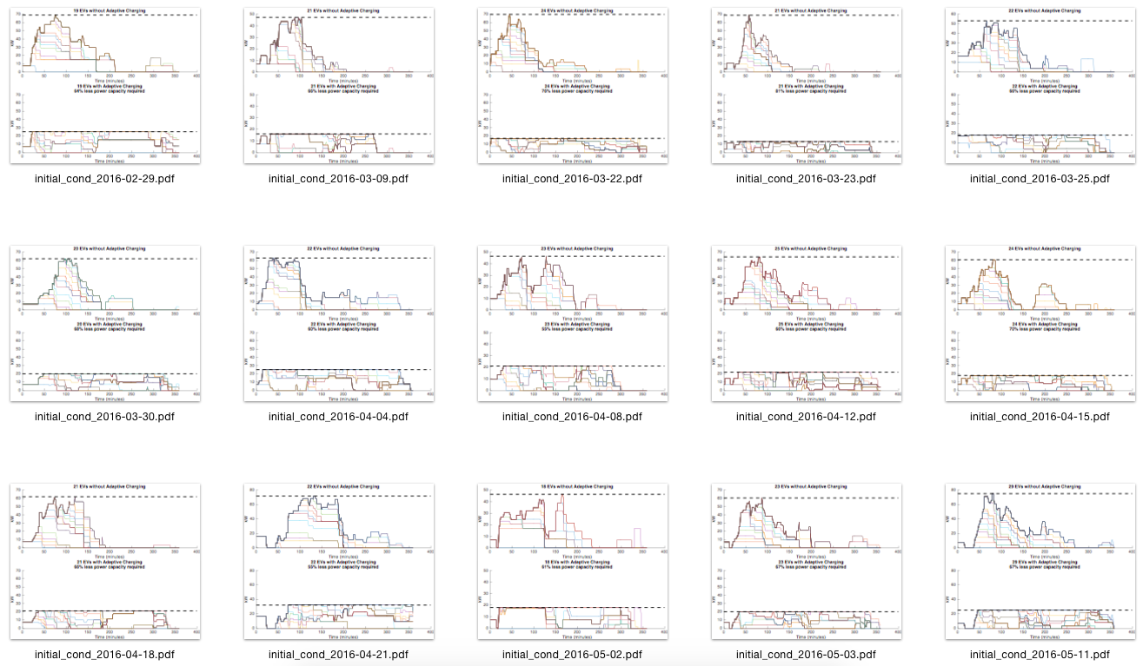
Performance
data: g2016mtv2000
data: CAgarage2016
peak demand reduction
Caltech data (Feb – May, 2016)
savings = infrastructure, demand charge

Slide 53
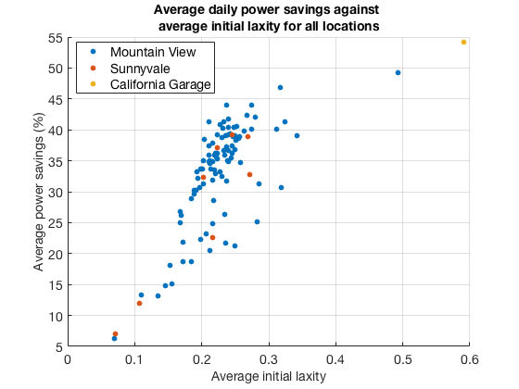
Adaptive charging network
Daily peak power | Unmanaged charging (kW) | PF (kW) | Power savings
Caltech | 85.3 | 33.8 | 60%
Mountain View | 46.2 | 28.4 | 39%
Sunnyvale | 94.0 | 56.2 | 40%
ACN min peak power
reducing capital &
operating costs
Conclusions
savings increase in initial laxity
significant savings even at low laxity
Karl Erliksson 2016 SURF
Notes:
The transformer capacity is 7.2 kW (25 kW shared between 4 houses). Each car can charge at a peak rate of 7.2 kW. Therefore all three cars charging at their peak rate will exceed the transformer limit.
The demo will run over 11 minutes with the following scenario:
Three cars will be plugged in at different times with different energy demands and departure times:
Car 1: arrives at time 0, departs at time 11 mins, needs 0.71 kWh.
Car 2: arrives at time 2 mins, departs at 5 mins, needs 0.36 kWh.
Car 3: arrives at time 3 mins, departs at 8 mins, needs 0.25 kWh.
The scenario is designed to illustrate the importance of smart charging (and other system functions; see below):
Dumb charging where each car charges at its peak will exceed transformer limit.
Static sharing policy will not satisfy EV energy demands.
Only dynamic adaptation based on real-time information can work, as shown in the diagram below.

Slide 54
Model and algorithms:
sLLF

Slide 55
Smoothed Least laxity first (sLLF)
energy
demand
(miles / kWh)
arrival /
departure
time
peak
charging
rate (kW)
no look-ahead

Slide 56
Smoothed Least laxity first (sLLF)
energy
demand
(miles / kWh)
arrival /
departure
time
peak
charging
rate (kW)
remaining
time
minimum
required

Slide 57
Smoothed Least laxity first (sLLF)
Algorithm: max min laxity at next time
Nakahira, et al, e-Energy 2017

Slide 58
Smoothed Least laxity first (sLLF)
Theorem
sLLF rates solves
➔ water-filling algorithm
Nakahira, et al, e-Energy 2017

Slide 59
Smoothed Least laxity first (sLLF)
Theorem
sLLF rates are
Proportionally fair
Maxmin fair
Nakahira, et al, e-Energy 2017

Slide 60
Smoothed Least laxity first (sLLF)

